Slide 1
GAN Lab: Understanding Complex Deep Generative Models using Interactive Visual Experimentation Published by: Minsuk Kahng, Nikhil Thorat, Duen Horng (Polo) Chau, Fernanda B. Vi´egas, and Martin Wattenberg
Presented by: Mauzor Ilonzo

Slide 2
Synopsis
GAN Lab - The first interactive tool designed for non-experts to learn and experiment with GAN models.
GAN [Generated Adversarial Networks] Models are a class of deep learning models known for their ability to create synthetic [fake] images that look like natural [real] images. They are both difficult to train and difficult to understand, even by experts.

Slide 3
GAN Model Basics
The architecture of GANs is composed of two neural networks, called generator and discriminator, and is often represented as an abstracted data-flow graph.
The generator, G, takes a random noise vector, z, as input and transforms it into a fake sample, G(z) (represented as a multi-dimensional vector)
The discriminator, D, is a binary classifier that takes either a real or fake sample, and determines if it is real or fake (D(x) represents the probability that x is real rather than fake).

Slide 4
GAN Lab’s Structure - Color
In GAN Lab’s visualizations, they employ the following color scheme:
Real data is colored green.
Fake data is colored purple.
The discriminator’s visualizations are colored blue.
The generator’s visualizations are colored purple.

Slide 5
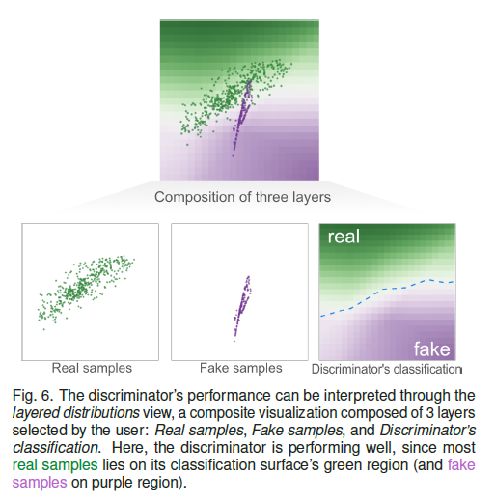
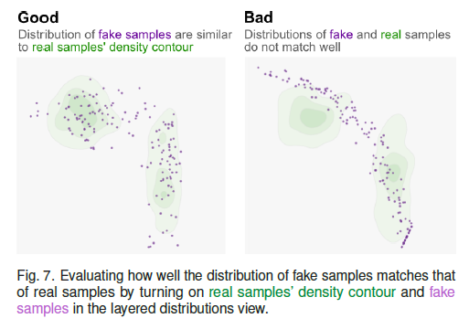
GAN Lab Example

Slide 6
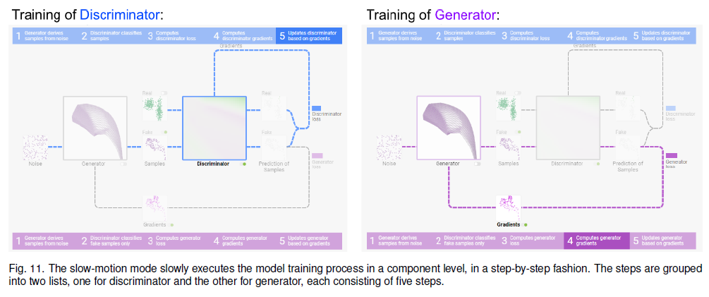
GAN Model Training

Slide 7
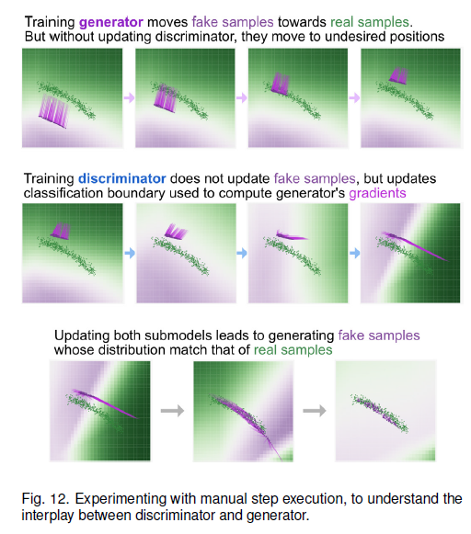
GAN Model Training Results

Slide 8
GAN Lab’s Structure - Interactivity
The most basic interaction is the running of the GAN model’s training through clicking the play button at the top of the interface.
During the GAN model’s training, the intermediate results visualizations are updated dynamically every n epochs (a.k.a. iterations).
Users can pause the training by clicking the pause button (which is the play button since it changes to a pause button during the training).

Slide 9
GAN Lab’s Structure - Interactivity
GAN Lab users can directly change the model’s hyperparameters & values using the buttons/dropdown menus.
Available Hyperparameters in GAN Labs
Number of layers for generator and discriminator
Number of neurons in each layer for generator & discriminator
Optimizer type for updating the generator and discriminator
Learning rates for updating the generator and discriminator
Loss function
Number of training runs for discriminator & the generator) for every epoch5
Noise dimension (i.e., 1D, 2D) and distribution type (i.e., uniform, Gaussian)

Slide 10
Limitations & Future Work
GAN Lab does not currently support image data, since working with image data takes a large amount of time.
GAN Lab also does not support all types of GAN model variants and some of those models would require tweaks to the interface.
GAN Lab’s browsers are currently single threaded, meaning that they cannot render visualizations and perform computations at the same time.

Slide 11
GAN Lab Demo Link
https://poloclub.github.io/ganlab/

Slide 12
ANY QUESTIONS?

